Slide 1
RECOMMENDATION SYSTEMS FOR ONLINE LEARNING PLATFORMS
Done by:
G. Reetu (192212112)/ECE
N. Swapna sree (192220029)/BI
Guided by:
Dr R DhanaLakshmi

Slide 2
PROBLEM STATEMENT
Project: Recommendation System for Online Learning Platforms
Problem Statement: As online learning platforms continue to grow in popularity, the sheer volume of courses, tutorials, and resources can overwhelm learners, making it difficult for them to find content tailored to their specific interests and needs. A personalized recommendation system can address this challenge by suggesting relevant courses based on user preferences, learning history, and behavior, thereby improving user engagement and learning outcomes.
Tasks:
User profile creation with details on interests, skill level, and learning goals.
Tracking of user activity, such as courses enrolled in, completed, and rated.
Implementation of recommendation algorithms to suggest relevant courses.
A feedback mechanism for users to rate and provide input on recommended courses.
Real-time updates on recommended courses based on changing user preferences and behavior.
Display of trending and popular courses across the platform.
Outcome: The outcome of this project is to develop a Recommendation System for Online Learning Platforms that provides personalized course suggestions to users, helping them discover content aligned with their skills, goals, and interests. By leveraging machine learning algorithms, the system will analyze user activity, feedback, and course content to make tailored recommendations, thereby enhancing the user experience and encouraging continuous learning.

Slide 3
AIM
The aim of this project is to develop a Personalized Recommendation System for Online Learning Platforms that enhances user experience by providing tailored course suggestions. The system is designed to:
Address the challenge of overwhelming course options by suggesting relevant content based on user preferences, learning history, and behavior.
Improve learner engagement and satisfaction through personalized recommendations that align with individual skills, goals, and interests.
Encourage continuous learning by dynamically updating suggestions as user preferences and activities evolve.
Promote efficient course discovery by leveraging machine learning algorithms and user feedback mechanisms.
Facilitate a user-centric approach in online education, helping learners achieve their goals with targeted learning paths and actionable insights.
This system aims to make online education more accessible, adaptive, and engaging for diverse learners worldwide.

Slide 4
ABSTRACT
This project aims to develop a personalized recommendation system to simplify content discovery for learners.
By leveraging user data such as preferences, learning history, and behavior, the system utilizes advanced machine learning algorithms to provide tailored course suggestions.
The proposed solution enhances user engagement by delivering relevant recommendations, encouraging continuous learning, and optimizing the learning experience.
The real-time updates ensure that the recommendations remain dynamic and adaptive to users’ evolving needs.
By improving accessibility to appropriate content, this system fosters a more efficient, enjoyable, and impactful learning journey for users, ultimately driving the success and adoption of online learning platforms.
Improved Platform Retention: By addressing user frustration caused by choice overload, the recommendation system helps retain users, contributing to the platform's growth and sustainability.
Scalability and Versatility: The system is designed to handle diverse user profiles and large-scale datasets, making it adaptable for various online learning platforms and content types.
User-Centric Feedback Integration: Incorporating a robust feedback mechanism enables the system to refine its suggestions continuously, ensuring accuracy and relevance while enhancing user satisfaction.

Slide 5
INTRODUCTION
The rise of online learning platforms has revolutionized education, offering users access to a wealth of courses and resources on diverse topics. From academic subjects to professional skills and personal development, these platforms cater to learners worldwide. However, the vast amount of available content can often overwhelm users, making it difficult to identify courses that align with their individual preferences, skill levels, and learning goals. Personalized recommendation systems have emerged as a solution to this challenge. These systems leverage data such as user interests, learning history, behavior, and feedback to provide tailored course suggestions. By offering content that resonates with the learner’s needs, they enhance the overall learning experience, improve engagement, and encourage continuous learning.
This project focuses on developing a Recommendation System for Online Learning Platforms that integrates machine learning algorithms to analyze user behavior and course content. The system aims to provide dynamic and relevant course recommendations, thereby addressing the issue of choice overload and helping users discover valuable content efficiently.With features such as real-time updates, a feedback mechanism, and trending course suggestions, this recommendation system not only enhances user satisfaction but also promotes platform retention and growth. By aligning technology with user needs, this project seeks to bridge the gap between learners and their ideal educational resources.

Slide 6
CODE IMPLEMENTATION
Modules and Libraries for the Recommendation System
1. Input and Output Operations
stdio.h:
For reading and writing data files that contain user information, learning history, and course details.
Functions: fopen(), fscanf(), fprintf(), fclose().
2. String Manipulation
string.h:
To handle and process user preferences and course details stored as strings.
Functions: strcmp(), strstr(), strtok(), strlen().
3. Memory Management
stdlib.h:
For dynamic memory allocation and handling datasets of varying sizes.
Functions: malloc(), calloc(), realloc(), free().
4. Mathematical Computations
math.h:
For calculations used in recommendation algorithms, such as similarity measures.
Functions: sqrt(), pow(), fabs(), trigonometric operations for cosine similarity.
5. Data Structures
Custom or Standard Implementations:
Arrays, linked lists, or hash tables for storing user and course data.
Libraries like GLib (if available) for advanced data structures like dynamic arrays or hash tables.
6. Recommendation Algorithm Implementation
Custom Code for Algorithms:
Collaborative filtering: Implement functions to calculate similarity between users or items.
Content-based filtering: Write logic to compare course content with user preferences.
Hybrid models: Combine collaborative and content-based methods.
7. JSON or Structured Data Parsing
cJSON or JSON-C:
For parsing or generating JSON data files that store user behavior and course details.
8. File Handling
stdio.h:
For reading user behavior logs (e.g., which courses they viewed, completed, or rated).
Use CSV or plain text as data storage.
Optional Modules for Additional Features
9. Real-Time Recommendations
sys/socket.h and netinet/in.h:
For creating a basic server-client system to provide recommendations over a network.
10. Parallel Processing (for Scalability)
OpenMP:
To parallelize computation-heavy tasks like similarity calculation for large datasets.
11. External Integration
SQLite or Other Embedded Databases:
Use SQLite (via the SQLite C API) to store user data, learning history, and course metadata in a structured way.
12. Visualization and Analysis
GNUPLOT or CSV Export:
For creating visualizations or exporting data for analysis using external tools.

Slide 7
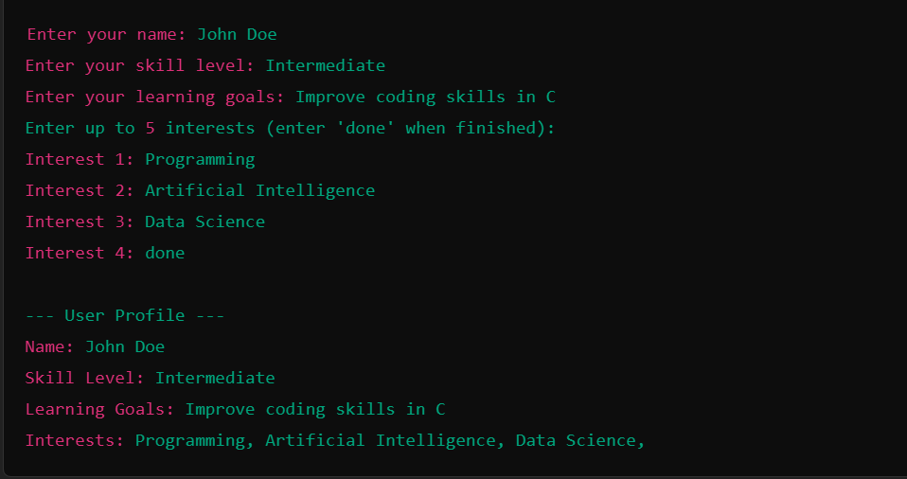
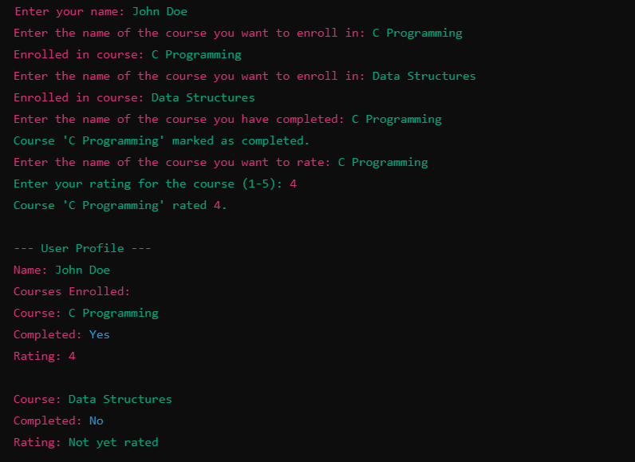
OUTPUT:
User profile creation with details on interests, skill level, and learning goals
Tracking of user activity, such as courses enrolled in, completed, and rated.

Slide 8
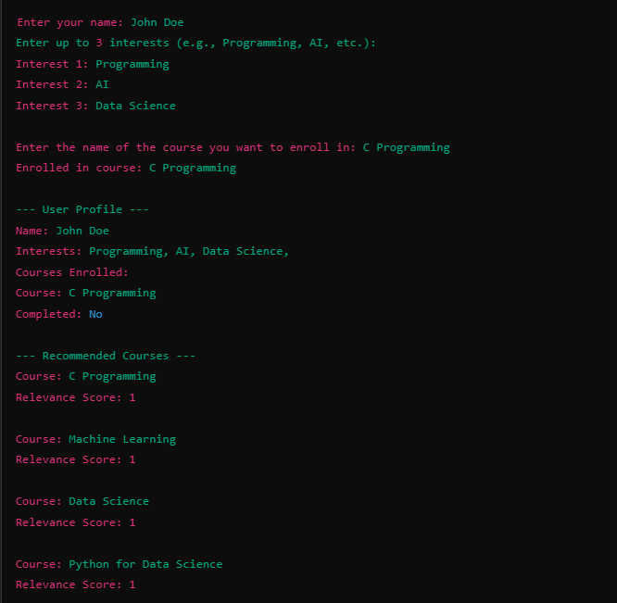
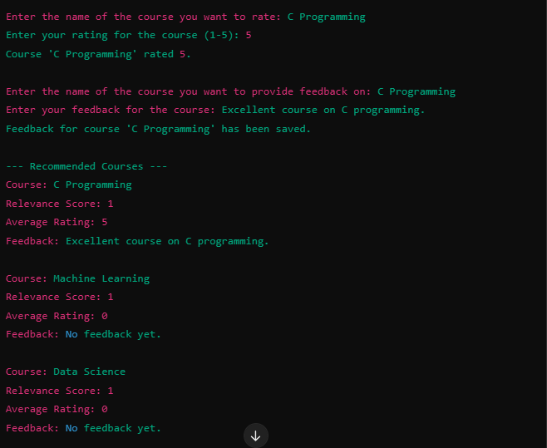
Recommendation algorithms to suggest relevant courses.
A feedback mechanism for users to rate and provide input on recommended courses.

Slide 9
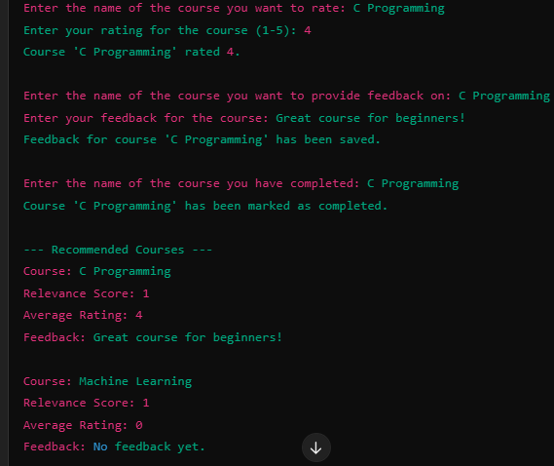
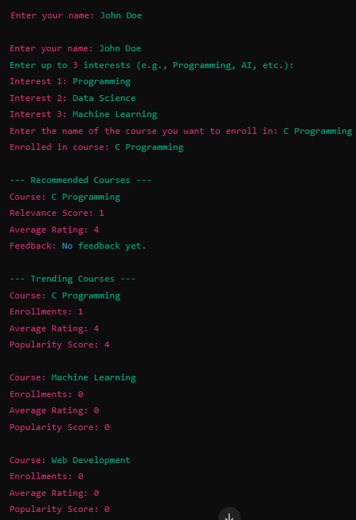
Real-time updates on recommended courses based on changing user preferences and behavior.
Display of trending and popular courses across the platform.

Slide 10
ENGINEERING STANDARDS
1. Software Development Standards
ISO/IEC 25010 (System and Software Quality Models):Ensure the system is functional, reliable, maintainable, and user-friendly. Key attributes to focus on:
Functionality: Accurate and relevant course recommendations.
Performance Efficiency: Fast response times for real-time recommendations.
Usability: Intuitive interface for both learners and administrators.
IEEE 1012 (Verification and Validation):
Follow a structured process to validate that the recommendation system meets the defined requirements and provides accurate suggestions.
Core Standards of ISO/IEC 9899: Language Syntax and Semantics
Specification of C syntax, including keywords, operators, expressions, and statements.
Detailed rules for variable declarations, type definitions, and storage classes.
Support for data types (e.g., int, float, char, double, pointers, structures, and unions).
Standard LibraryDefinition of the standard library headers and their functionality
Input/Output: <stdio.h> for input and output functions like printf and scanf.
ISO/IEC 19501 (UML for System Modeling):
Use standard modeling techniques to design a scalable and modular system architecture.
IEEE 1471 (System Architecture):
Define the system architecture to ensure compatibility with diverse platforms and technologies.

Slide 11

FUTURE SCOPE
The proposed personalized recommendation system can be extended and improved to address evolving user needs and technological advancements. Below are some key areas of future development:
Advanced Recommendation Techniques
Enhanced User Profiling
Gamification and Engagement
Scalability and Performance
Improved Feedback Mechanisms
Real-Time and Context-Aware Recommendations
Diversified Content Recommendations
Integration with Emerging Technologies

Slide 12
CONCLUSION
In conclusion, the personalized recommendation system for online learning platforms plays a pivotal role in enhancing the user experience by offering tailored course suggestions that align with individual preferences, learning history, and goals. With the rapid expansion of online learning content, this system addresses the challenge of content overload by helping learners efficiently navigate through a wide array of available resources.
By leveraging machine learning algorithms, user profiling, and real-time feedback mechanisms, the system not only improves course discovery but also encourages continuous learning, user engagement, and course completion. The dynamic and adaptive nature of the recommendation engine ensures that suggestions remain relevant as users' interests and goals evolve over time.
The implementation of this recommendation system is a step towards creating smarter, more intuitive online learning environments, where users can receive personalized, engaging, and valuable learning experiences. Furthermore, as the system evolves, integrating advanced technologies such as AI, big data, and gamification can further enhance its capabilities, ensuring that it remains responsive to both user needs and emerging trends in the education space.
Ultimately, the personalized recommendation system represents a critical advancement in making online learning more accessible, efficient, and enjoyable, fostering better learning outcomes and promoting lifelong education in an increasingly digital world.

Slide 13


